Slide 1

PYFAANG Stock Analysis
Pei-Ju Wu (Emily)
UC Berkeley Bootcamp

Slide 2
Introduction & objectives
Analyze FAANG stock data from 2012 to 2022. Gain insights into price trends, trading volumes, and market capitalization. Compare performance to the S&P 500 index. Provide investment recommendations based on risk profiles.
Notes:
based on risk taking ability

Slide 3

Data sources & DATA PROCESS & VISUALIZATION
YAHOO-FIN PYTHON OPEN-SOURCE LIBRARY
ALPHA VANTAGE API
PANDAS
MATPLOTLIB
SEABORN
Notes:
A Yahoo finance bulit-in library to retrive up-tp-date stock data

Slide 4
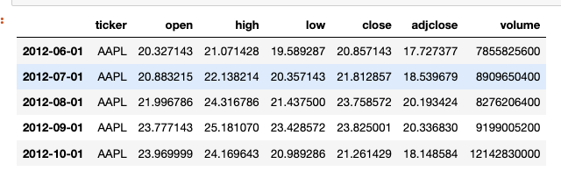
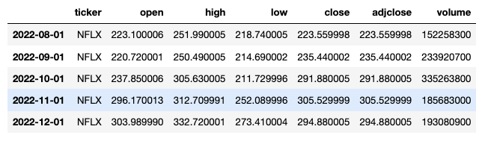
DATA FECTHING
The FAANG stock data covers 10 years on a monthly basis, starting from June 1, 2012, after the IPO of Meta in May 2012.
It includes monthly open, close, high, low prices, adjusted close prices, and trading volume.
Notes:
we gonna use sdjclose price for better reference since it accounting for stock splits, dividends, and other corporate actions.
When requesting the data from the built-in library, I asked for monthly basis interval to perform data cleaning and manipulation.

Slide 5
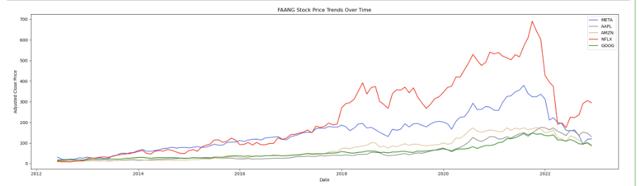
Price trends
The trend for FAANG companies shows a consistent increase in stock prices over the analyzed period.
Notes:
the 10-year period

Slide 6
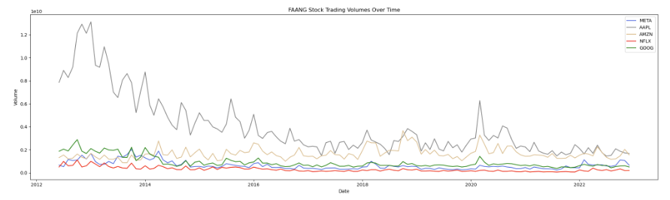
Trading volumes
Overall, there was a decrease in the trading volume trend. However, in the years of 2018 and 2020, there was a notable increase in trading volumes.
Notes:
combine with the previous slide we can see that the stock prices was in the uprising trend while the trading volumes were going down before 2020, indicating that the company is doing very well and the shareholders have less tendency to sell their stocks.
Now, let's dive deeper into the dataset to see why there is an opposite trend in both matrix

Slide 7
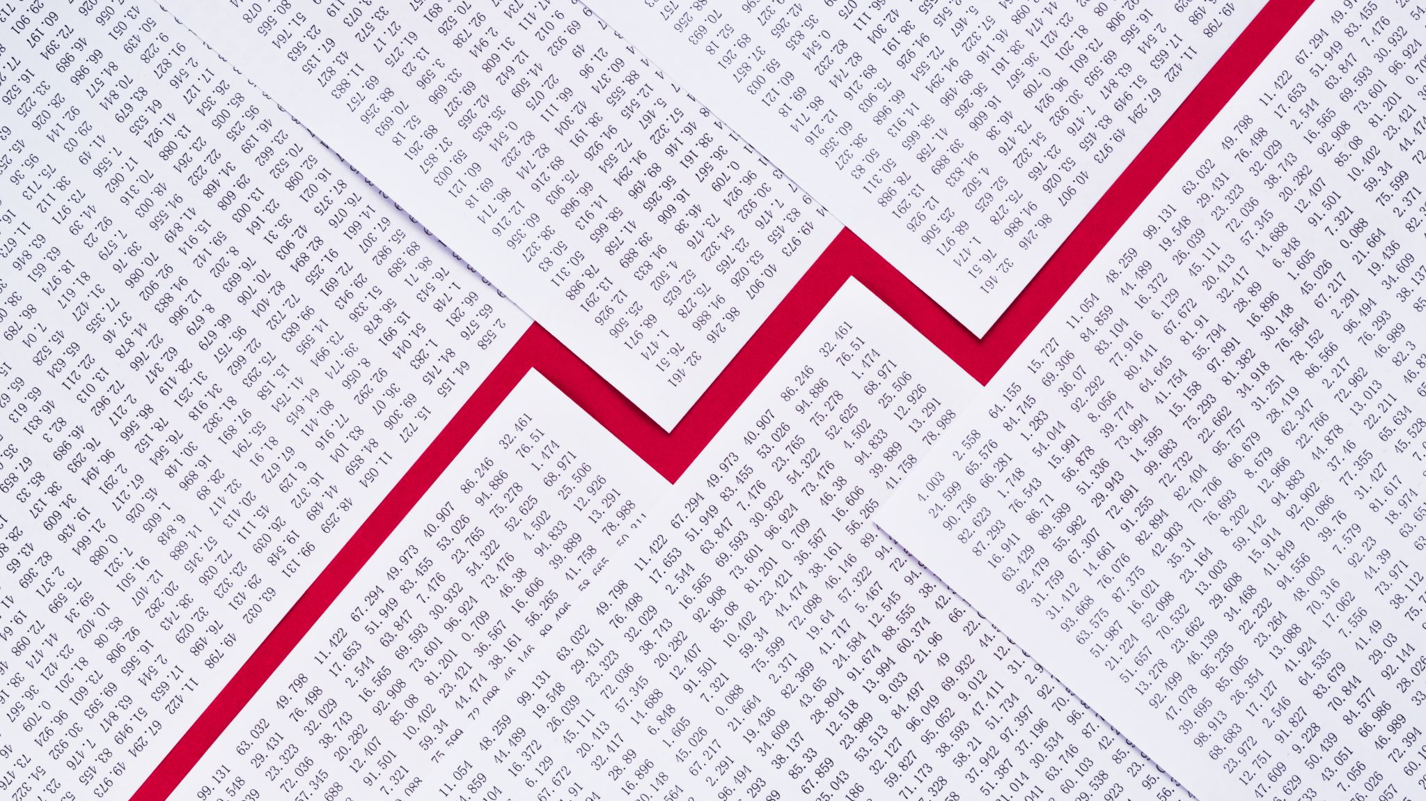
The Impact of COVID on the Stock Performance of FAANG Companies
Notes:
first thats take a look at the impact of covid

Slide 8
Focus on
Price Trends
Trading Volumes
Comparison of Market Cap
Pre-pandemic
During pandemic
Post-pandemic

Slide 9
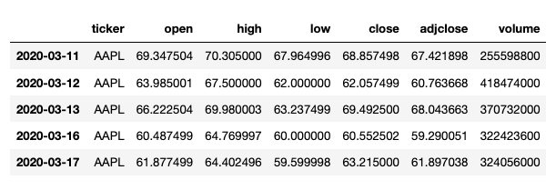
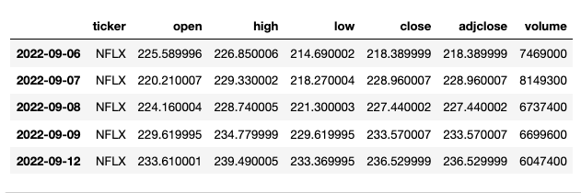
Covid dataset
The COVID period from March 11, 2020, to September 12, 2022, is represented using daily intervals to analyze the FAANG stock prices.
Notes:
since its a shorter period of time compare to the 10-year interval, i used data on daily basis to get a better understanding of the market.

Slide 10
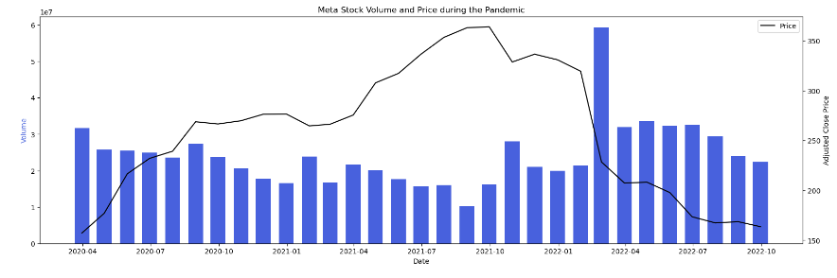

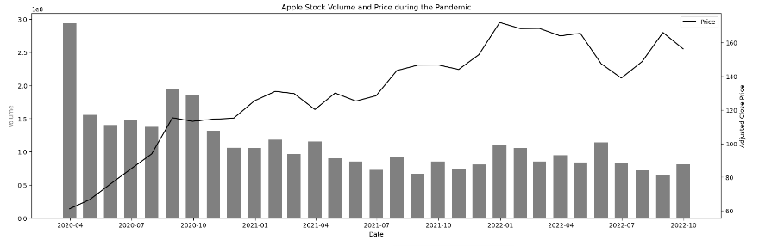

PRICE TRENDS & TRADING VOLUMES
Notes:
Resample the data into monthly basis for clear visualization
the bar graph represents the trending volume, and the line graph represents the prices trend for each company.

Slide 11
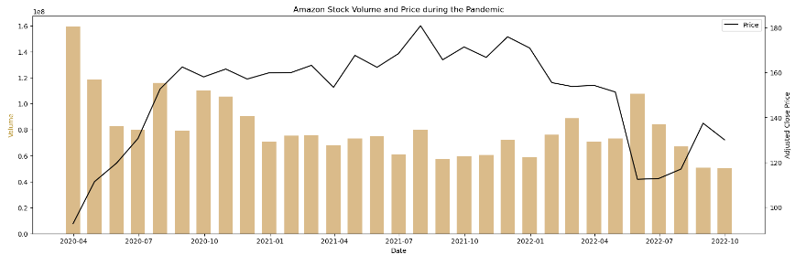


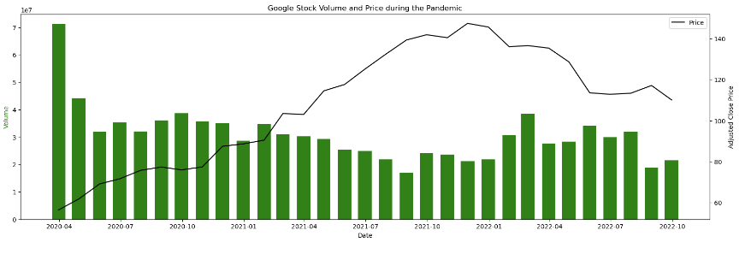
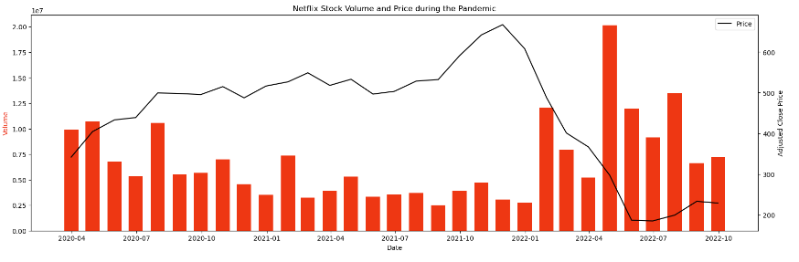
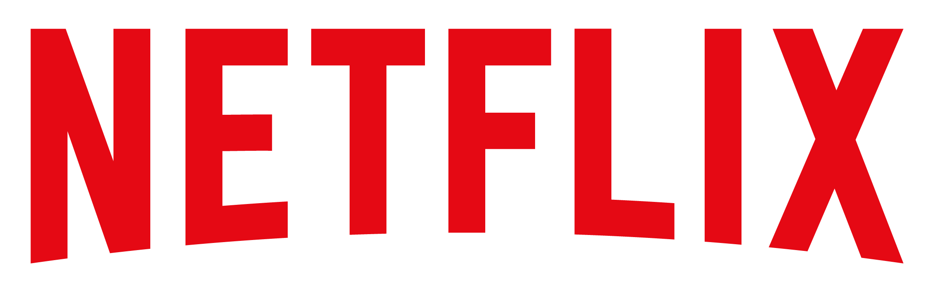
FAANG stocks initially dropped during the pandemic, except for Netflix. They later recovered, reflecting FAANG regained investors’ confidence.
Notes:
- point out netflix

Slide 12
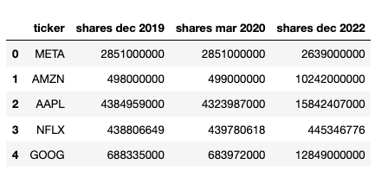
Share Data
Outstanding share data:
Pre-Pandemic (December 2019)
Pandemic (March 2020)
Post-Pandemic (December 2022)
Notes:
To calculate the market cap, we used the outstanding share data multiply by the stock price.
we wanna compare the market cap cahnge among 3 different time period which are pre-covid, during covid and pst-covid.
Since th yahoo-finance build-in library doesn’t provide market cap data for the certain period. I decided to use api and dictionary to parse out the data and put into a pandas data frame

Slide 13
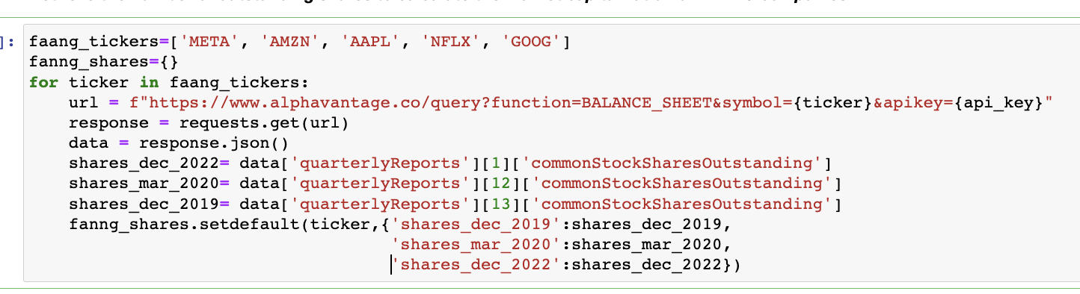
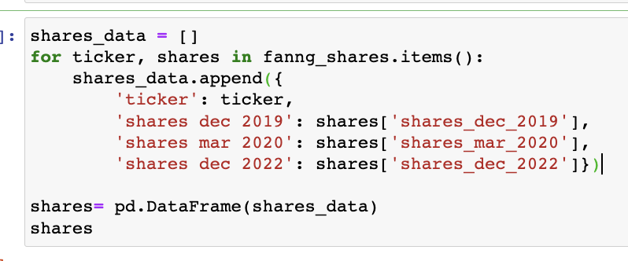
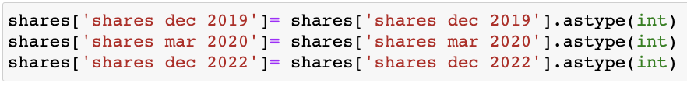
Using api and dictionary setdefalult function to collect outstanding share data from json file
- Using list to append share data in order to turn data into a pandas DataFrame
- Casting data type to integer
Notes:
- casting data type into integer fro data formatting and consistency

Slide 14
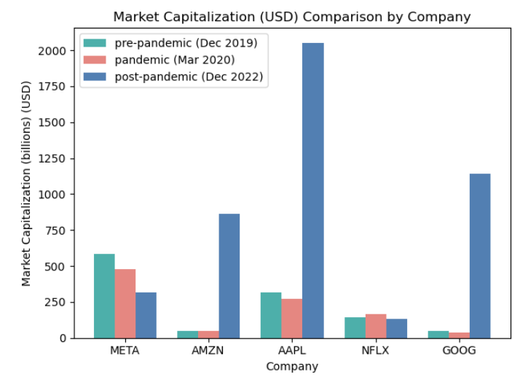
Calculating & comparing Market Cap
Multiplying Share Data with Stock Prices
During COVID Netflix Holds Strong
Amazon, Google, and Apple Stage Impressive Recovery in Post-COVID Era
Notes:
- we can see that during covid netflix holds strong- point out
meanwhile other companies more or less got afftected by covid
- however, anazon google and apple stage
- might because of compensatory consumption

Slide 15
Comparison of S&P 500 Index vs FAANG Stocks

Slide 16
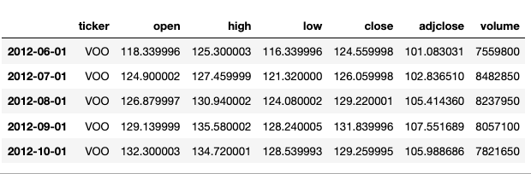
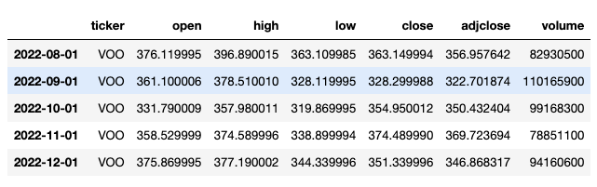
FECTCHING SP500 INDEX DATA
Utilizing the same interval and time span as the FAANG company data, the VOO ETF closely mirrors the performance of the S&P 500 Index.

Slide 17
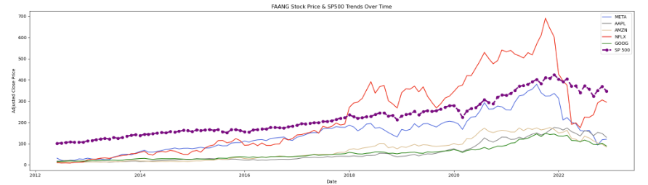
PRICE TRENDS COMPARSION
Most FAANG companies displayed a similar trend, aligning with the S&P 500 Index.
Notes:
However, Netflix showed a remarkable increase from 2018 to 2021, outperform the US total market. In 2022, the stock price began to decline, indicating mean reversion.

Slide 18
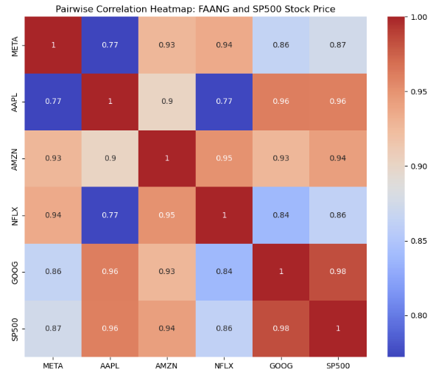
Correlation heatmap
Heatmap shows positive correlation between FAANG stocks and S&P 500, indicating a close relationship.
Notes:
the is a pairwise correlation heatmap of FAANG company and sp500 stock price.
since FAANG company are part of the S&P 500 index, here we use the correlation heat map to disentangle the effect of FAANG company on the S&P 500 index and also the correlation among them.
from this plot we can see that they are closely correlated to each other.

Slide 19
EXECUTIVE Summary
FAANG stocks demonstrate consistent price increase, making them attractive investments.
Apple, Google, and Amazon are relatively stable, while Netflix and Meta show higher volatility.
FAANG stocks offer long-term growth opportunities with different levels of risk and potential rewards based on individual preferences.
Notes:
in summary, based on all the data i mentioned above, we can conclude that first,

Slide 20
NEXT STEP
Utilizing Machine Learning Algorithms for Stock Price Prediction
Notes:
The future work of this project can be
Common algorithms include
Linear Regression,
Time series models like ARIMA stands for Autoregressive integrated moving average
and LSTM stands for Long Short-Term Memory networks.

Slide 21
THANK YOU

